Slide 1
Inhibitory Control in Language Games
Stephen Powell
University of Rochester
August 14th, 2015

Slide 2

Inhibitory Control
One’s ability to control behaviors, reactions, and disregard other stimuli in one’s environment
Inhibitory Control develops as children age

Slide 3
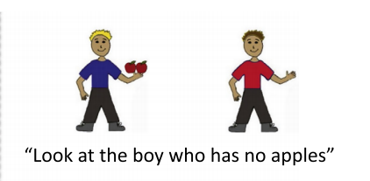
Prior Work: Negation
(Frank & Nordmeyer, 2014)

Slide 4
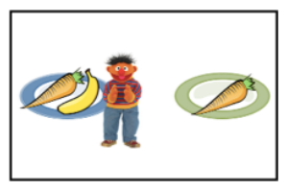
Prior Work: Ad Hoc Implicatures
(Frank, Wu, & Yoon, 2015)

Slide 5
Research Question
Could a child’s ability for inhibitory control be correlated with their success in comprehending negation and ad hoc implicatures?

Slide 6






Experiment Phases
Inhibition
Implicatures
Negation

Slide 7


Slide 8


Slide 9
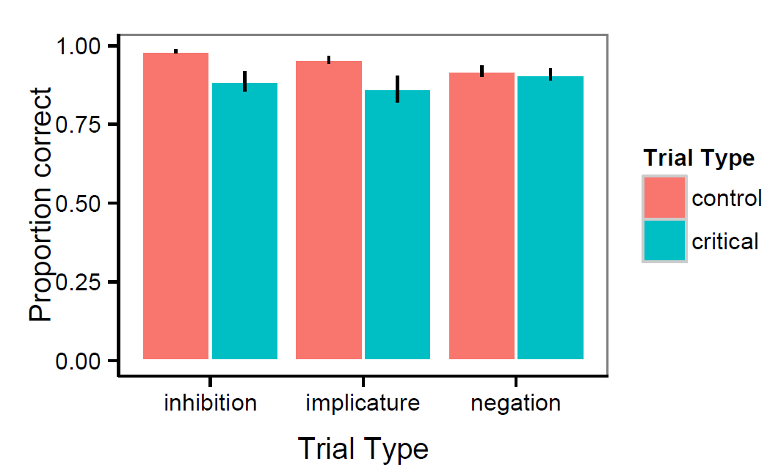
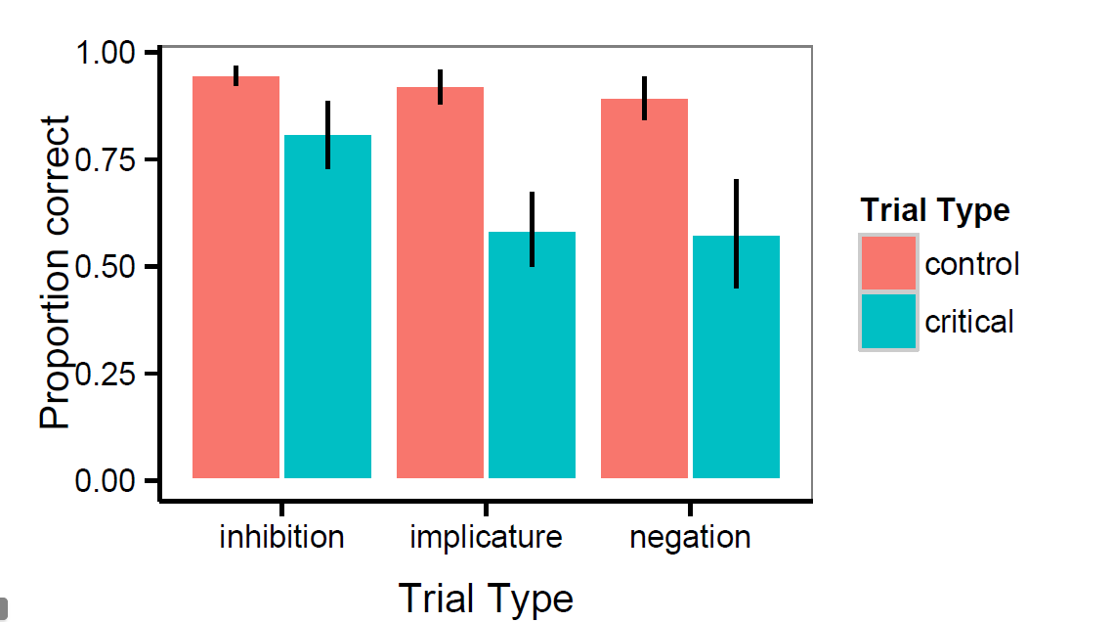
Accuracy
Adults
Children

Slide 10
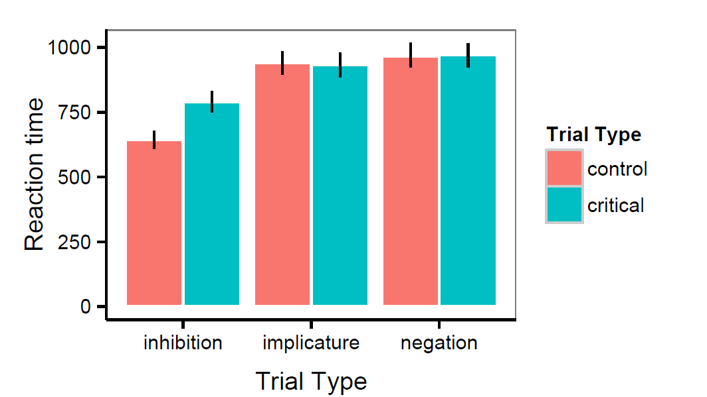
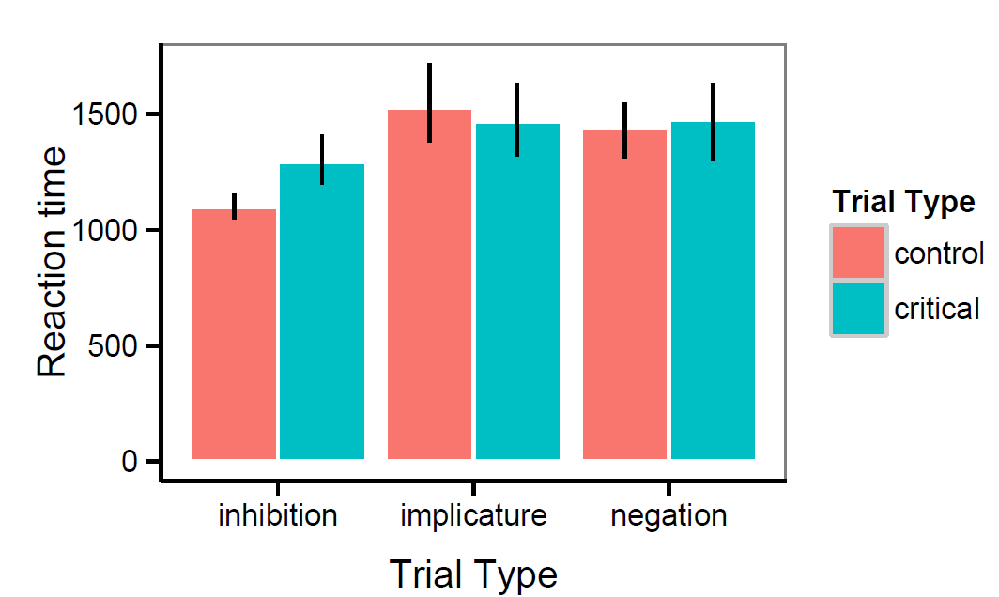
Reaction Time
Adults
Children

Slide 11
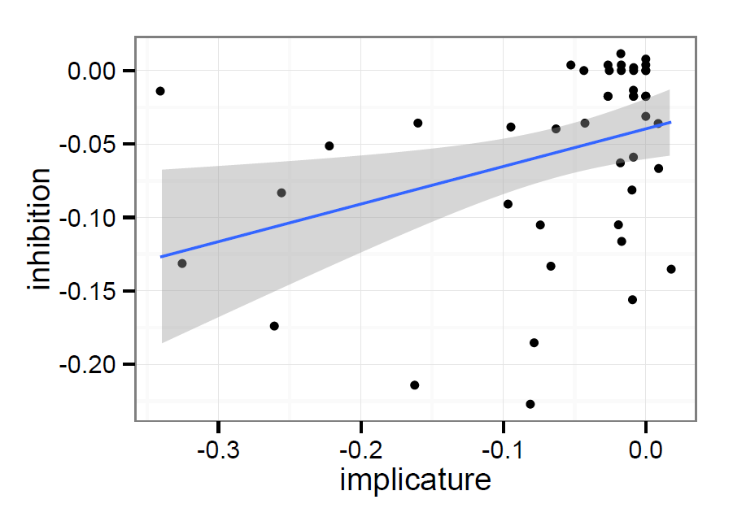
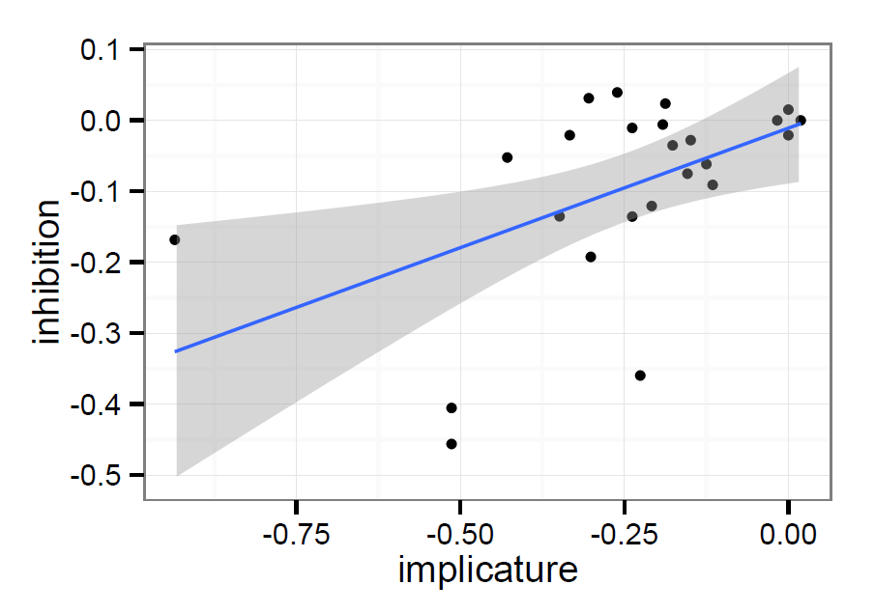
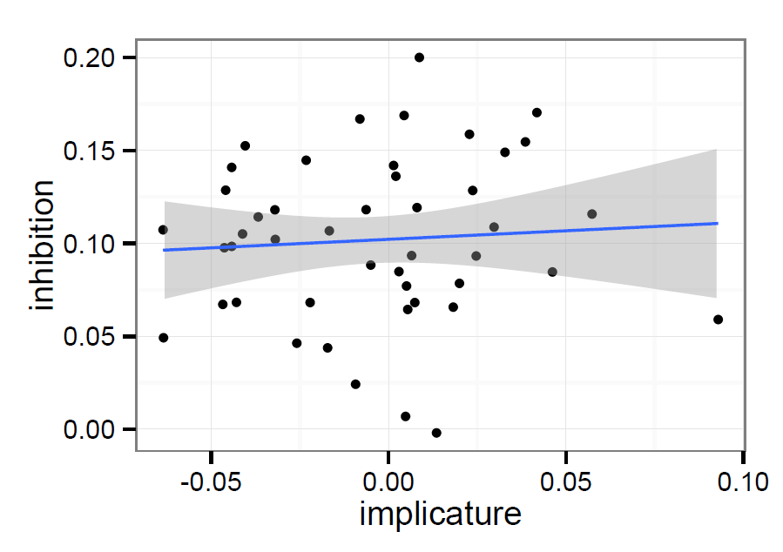
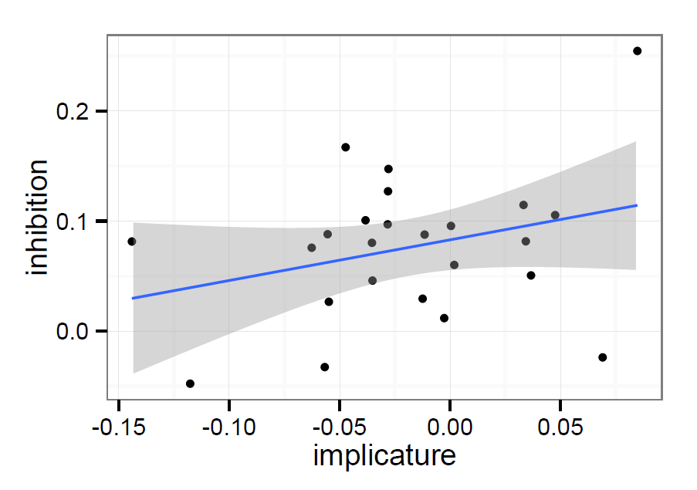
Implicatures Correlation
Adults
Children
Accuracy
Reaction Time

Slide 12
Compare to Prior Work
Ad Hoc Implicatures
Negation
A correlation between inhibition and ad hoc implicatures was not seen
This goes against the hypothesis that inhibitory control directly affects a child’s successful understanding of ad hoc implicatures
A correlation between inhibition and negation was not seen
This goes against the hypothesis that inhibitory control directly affects a child’s successful understanding of negation

Slide 13
Conclusions
Our experimental design was understood and reacted to as expected by participants
Perhaps a different executive function is influencing our results
Future Directions:
Redesign experiment to better isolate any correlation that may exist
Look to see effect of other executive functions on children’s pragmatic understanding

Slide 14


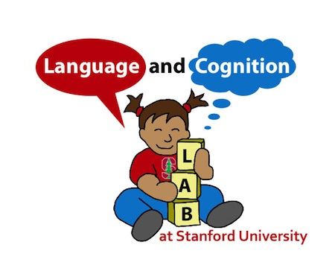


A Special Thanks To…
Ann Nordmeyer
Erica Yoon
Katherine Kaiser

Slide 15
Visual Stimuli

